Slide 1
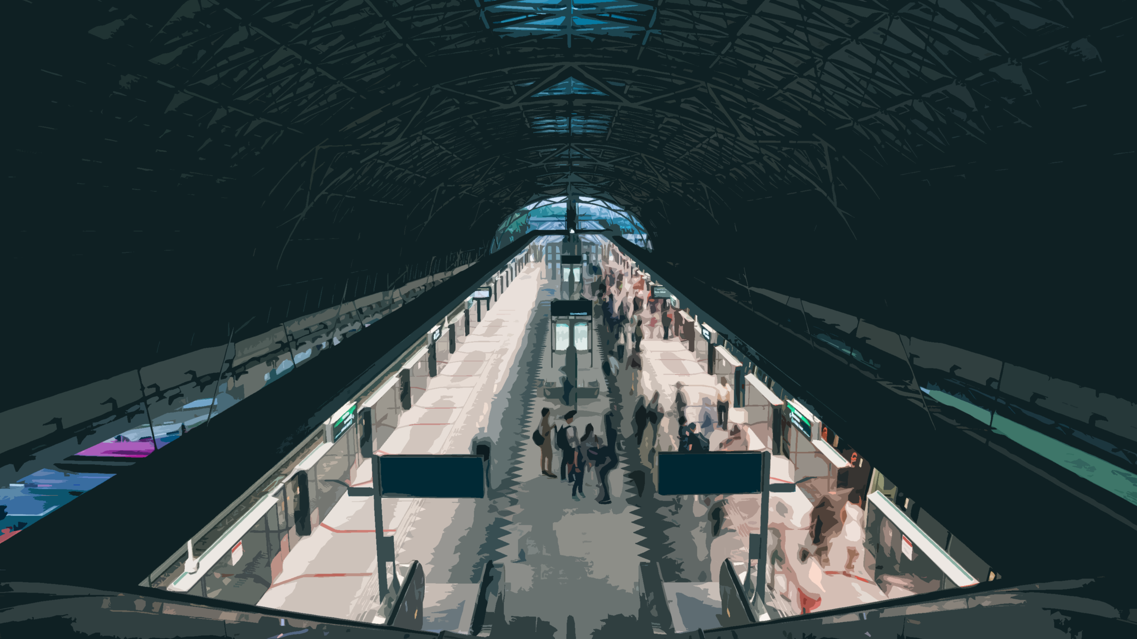
EI Project Demonstration
Public Transport System
Eugene Choy Wen Jia Ho Min Kit Winston Ho Wei Hong Sim Li Jin Yin Yukun Yong Fu Xiang
Group 3

Slide 2

Scenario
7.2M
Average Daily Trips
Any disruption would require swift mitigation actions to be taken to ensure minimal disruptions to the passengers.
A well-integrated public transport network across multiple systems with the various stakeholders will help enhance the communication and automate processes when mitigation actions are required

Slide 3
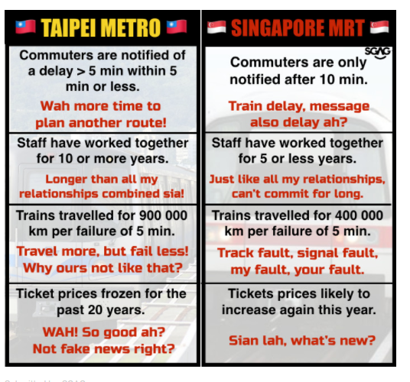
Motivation
"BRINGING YOU LATEST TRANSPORT UPDATE. EVEN FASTER THAN SMRT CORPORATION THROUGH INTEGRATION"

Slide 4
Key Processes
Train Breakdown and Resumption of Service
Weather Reporting
Schedule Polling

Slide 5

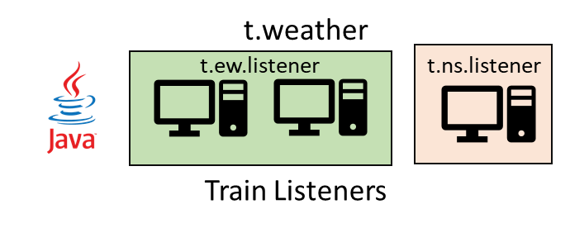
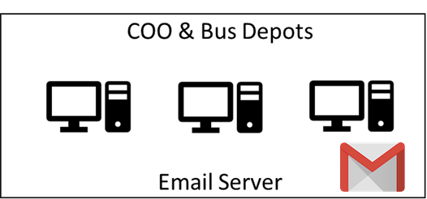

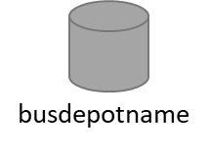
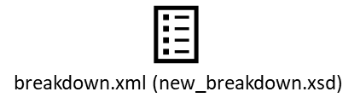



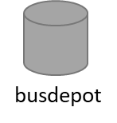
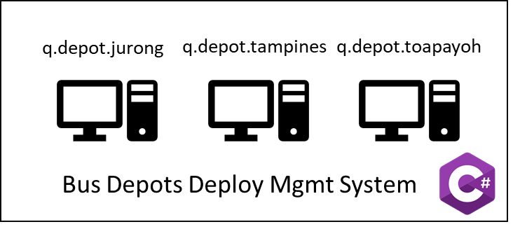


Break down messages
Heavy Rainfall Report
C t.weather
C t.<dynamic>.listener
SMTP
Send Emails
jdbc
P q.breakdown (Q)
P q.resumed(Q)
TIBCO BW
EMS
q.breakdown
q.deployed
q.resumed
q.depot.<dynamic>
t.weather
t.<dynamic>.listener
P q.deployed
C q.deployed (Q)
File Poller
busRequest.xml (new_busRequest.xsd)
Bus Management System
C q.depot.<dynamic>
HTTP
Breakdown_formatted.xml
(new_breakdown_formatted.xsd)
HTTP
HTTP

Slide 6
Train Breakdown and Resumption of Service Process

Slide 7
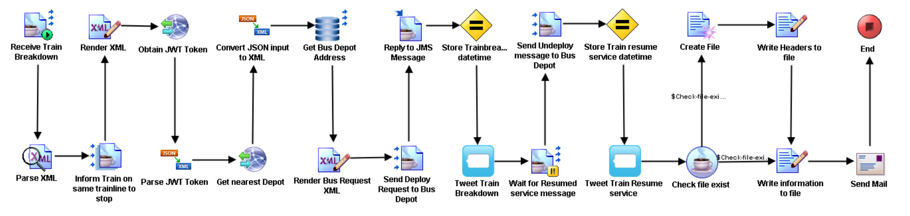
Process
Train Breakdown
Resumption of Service

Slide 8
Break down messages
Heavy Rainfall Report
t.weather
t.<dynamic>.listener
Send Emails
jdbc
P q.breakdown (Q)
P q.resumed(Q)
TIBCO BW
EMS
q.breakdown
q.deployed
q.depot.<dynamic>
t.weather
t.<dynamic>.listener
P q.deployed
C q.deployed (Q)
File Poller
Bus Management System
busRequest.xml (new_busRequest.xsd)
C q.depot.<dynamic>
HTTP
Breakdown_formatted.xml
(new_breakdown_formatted.xsd)
HTTP
HTTP

Slide 9
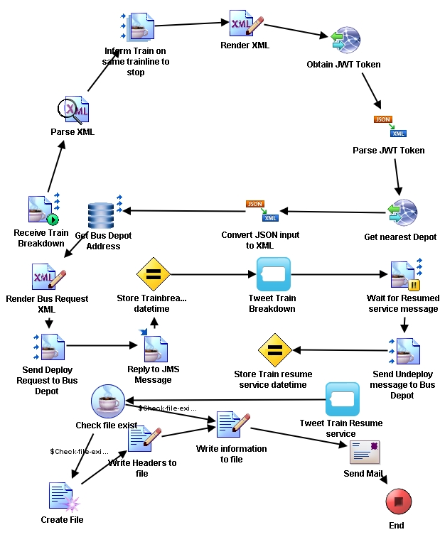

Slide 10


Slide 11
Weather Reporting Process

Slide 12
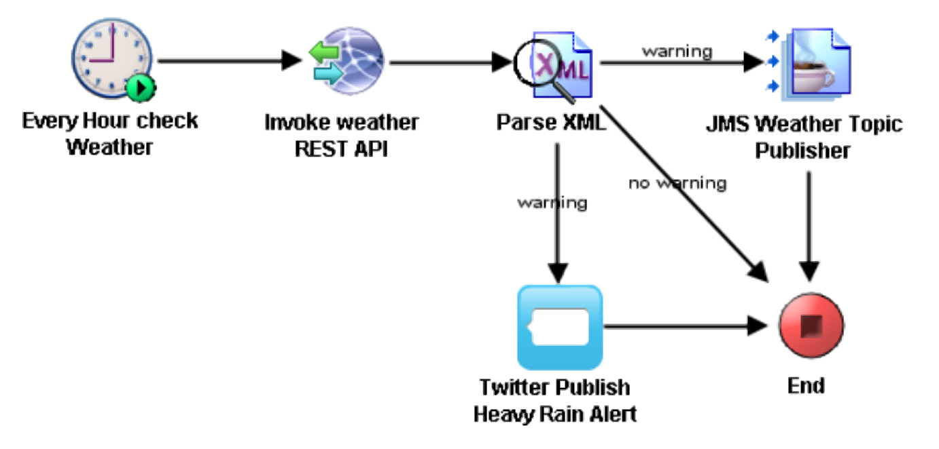
Process

Slide 13
Break down messages
Heavy Rainfall Report
t.weather
t.<dynamic>.listener
Send Emails
jdbc
P q.breakdown (Q)
P q.resumed(Q)
TIBCO BW
EMS
q.breakdown
q.deployed
q.depot.<dynamic>
t.weather
t.<dynamic>.listener
P q.deployed
C q.deployed (Q)
File Poller
busRequest.xml (new_busRequest.xsd)
Bus Management System
C q.depot.<dynamic>
HTTP
Breakdown_formatted.xml
(new_breakdown_formatted.xsd)
HTTP
HTTP

Slide 14
Schedule Polling Process

Slide 15
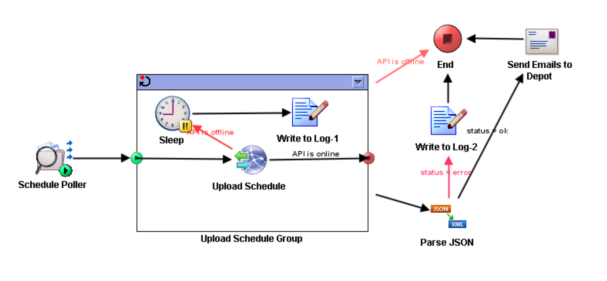
Process

Slide 16

Break down messages
Heavy Rainfall Report
t.weather
t.<dynamic>.listener
Send Emails
jdbc
P q.breakdown (Q)
P q.resumed(Q)
TIBCO BW
EMS
q.breakdown
q.deployed
q.depot.<dynamic>
t.weather
t.<dynamic>.listener
P q.deployed
C q.deployed (Q)
File Poller
busRequest.xml (new_busRequest.xsd)
C q.depot.<dynamic>
HTTP
Breakdown_formatted.xml
(new_breakdown_formatted.xsd)
HTTP
HTTP

Slide 17
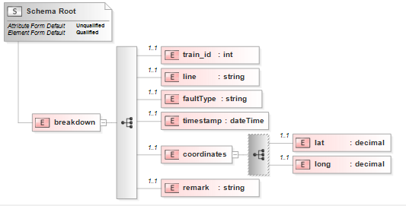
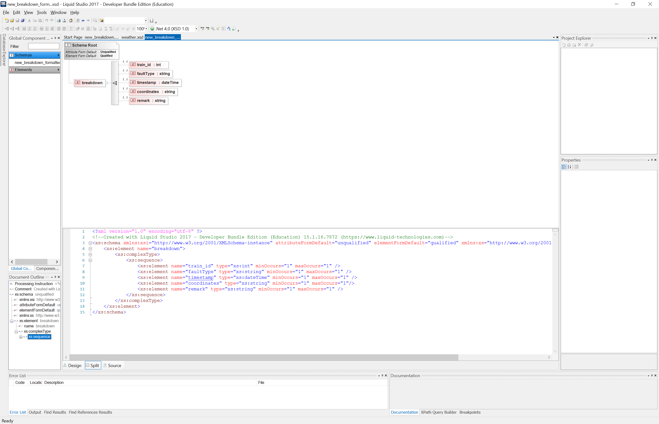
XML
<?xml version = "1.0" encoding = "UTF-8"?>
<breakdown xmlns:xsi = "http://www.w3.org/2001/XMLSchema-instance" xsi:noNamespaceSchemaLocation = "..\\new_breakdown.xsd">
<train_id>3</train_id>
<line>ew</line>
<faultType>Train Fault</faultType>
<timestamp>2018-02-20T09:00:00</timestamp>
<coordinates>
<lat>1.3272383</lat>
<long>103.9443528</long>
</coordinates>
<remark>Tanah Merah Station</remark>
</breakdown>
new_breakdown.xsd
<?xml version="1.0" encoding="UTF-8"?>
<breakdown>
<train_id>3</train_id>
<faultType>Train Fault</faultType>
<timestamp>2018-02-20T09:00:00</timestamp>
<coordinates>1.3272383,103.9443528</coordinates>
<remark>Tanah Merah Station</remark>
</breakdown>
new_breakdown_formatted.xsd

Slide 18
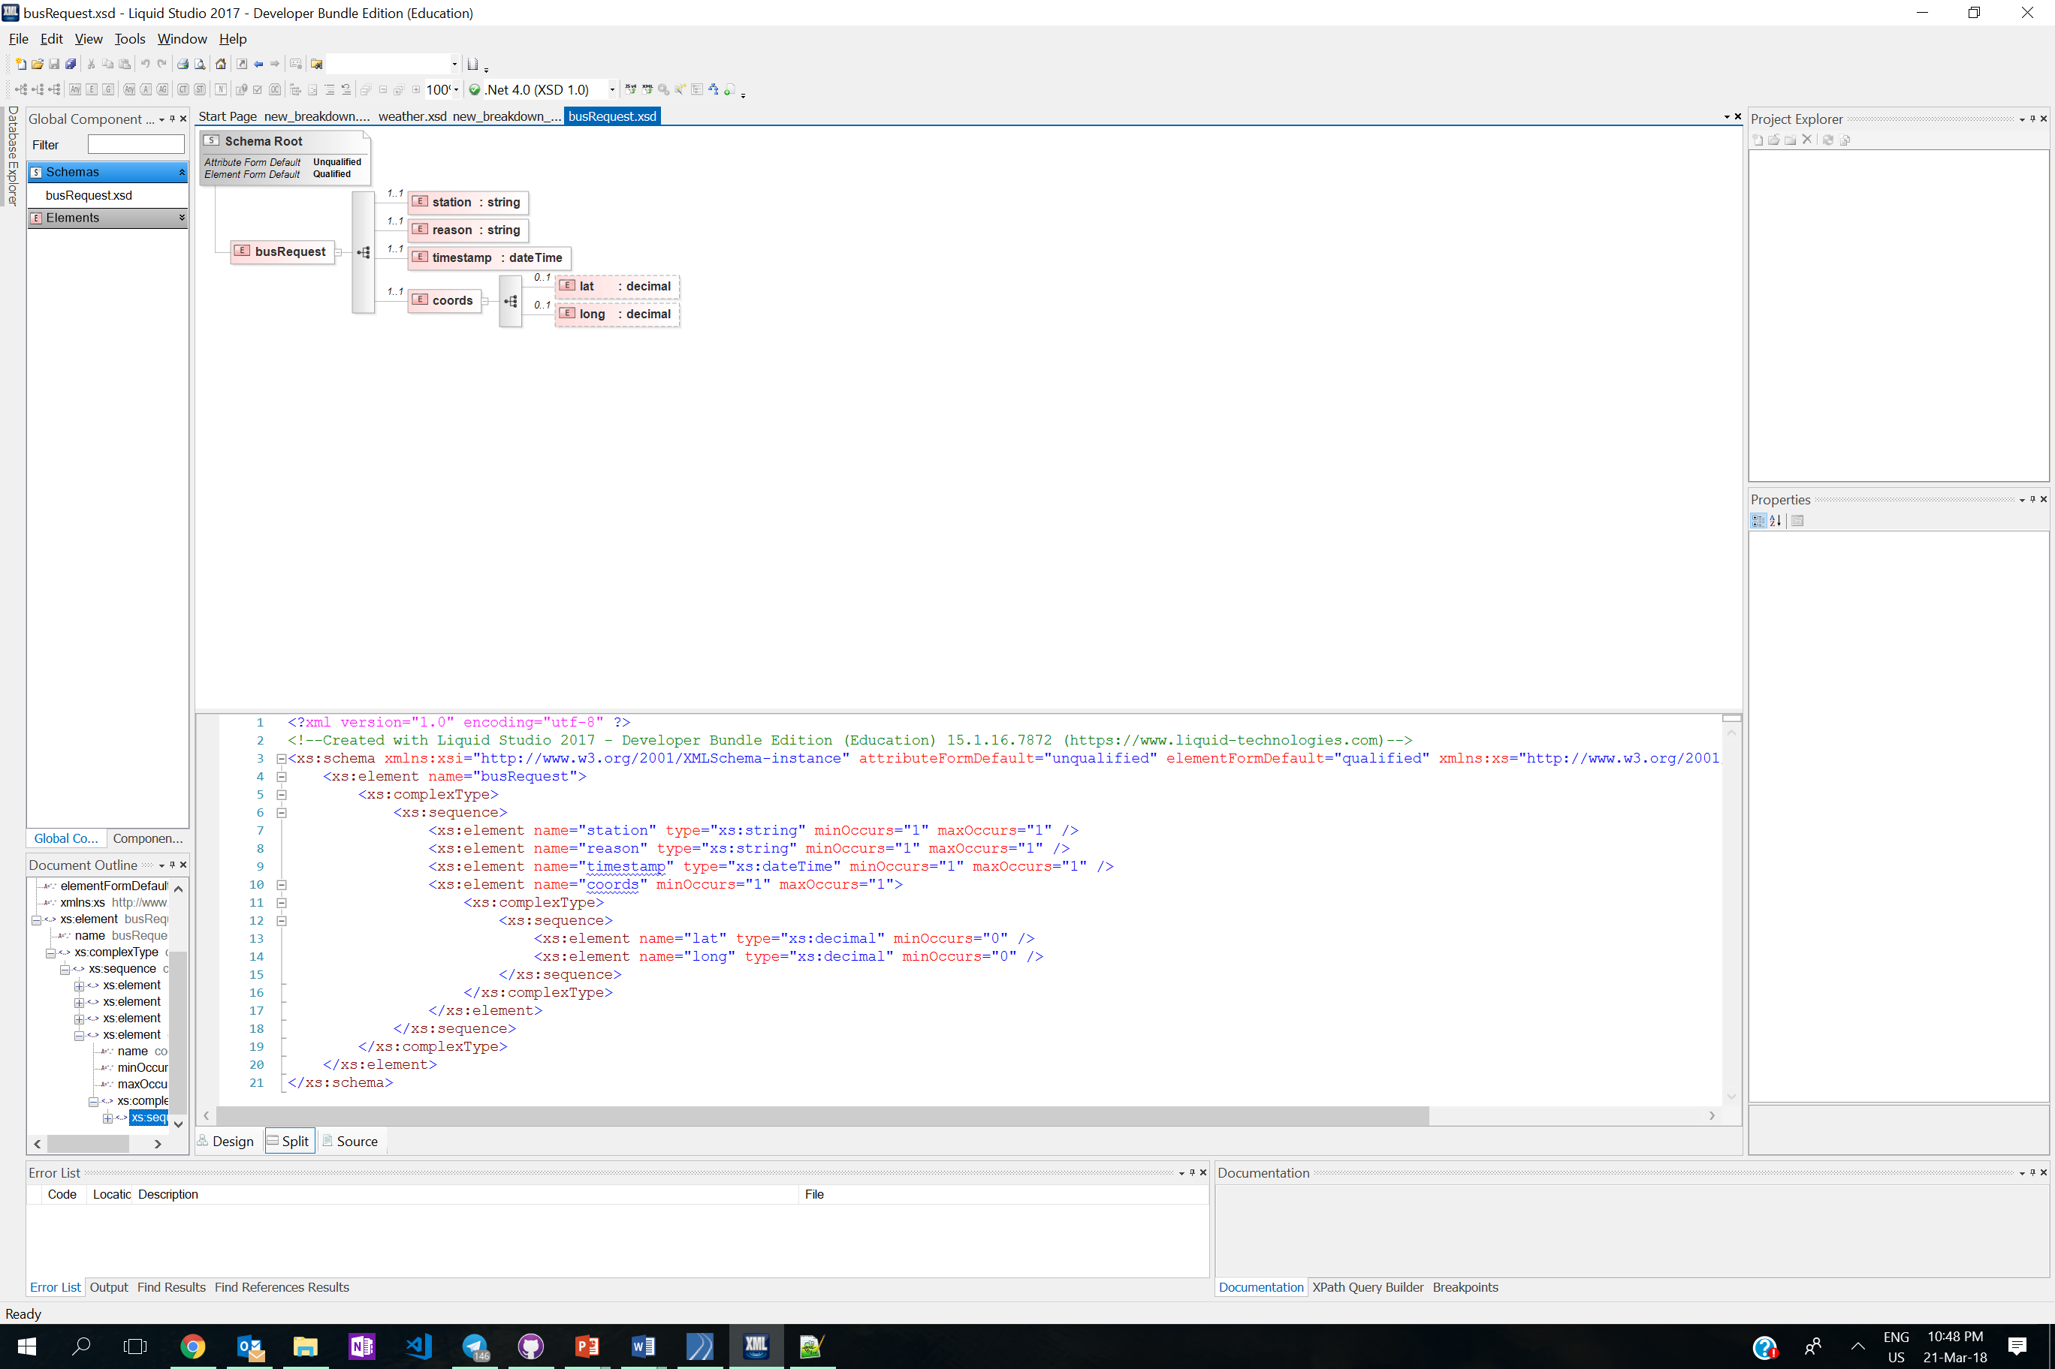
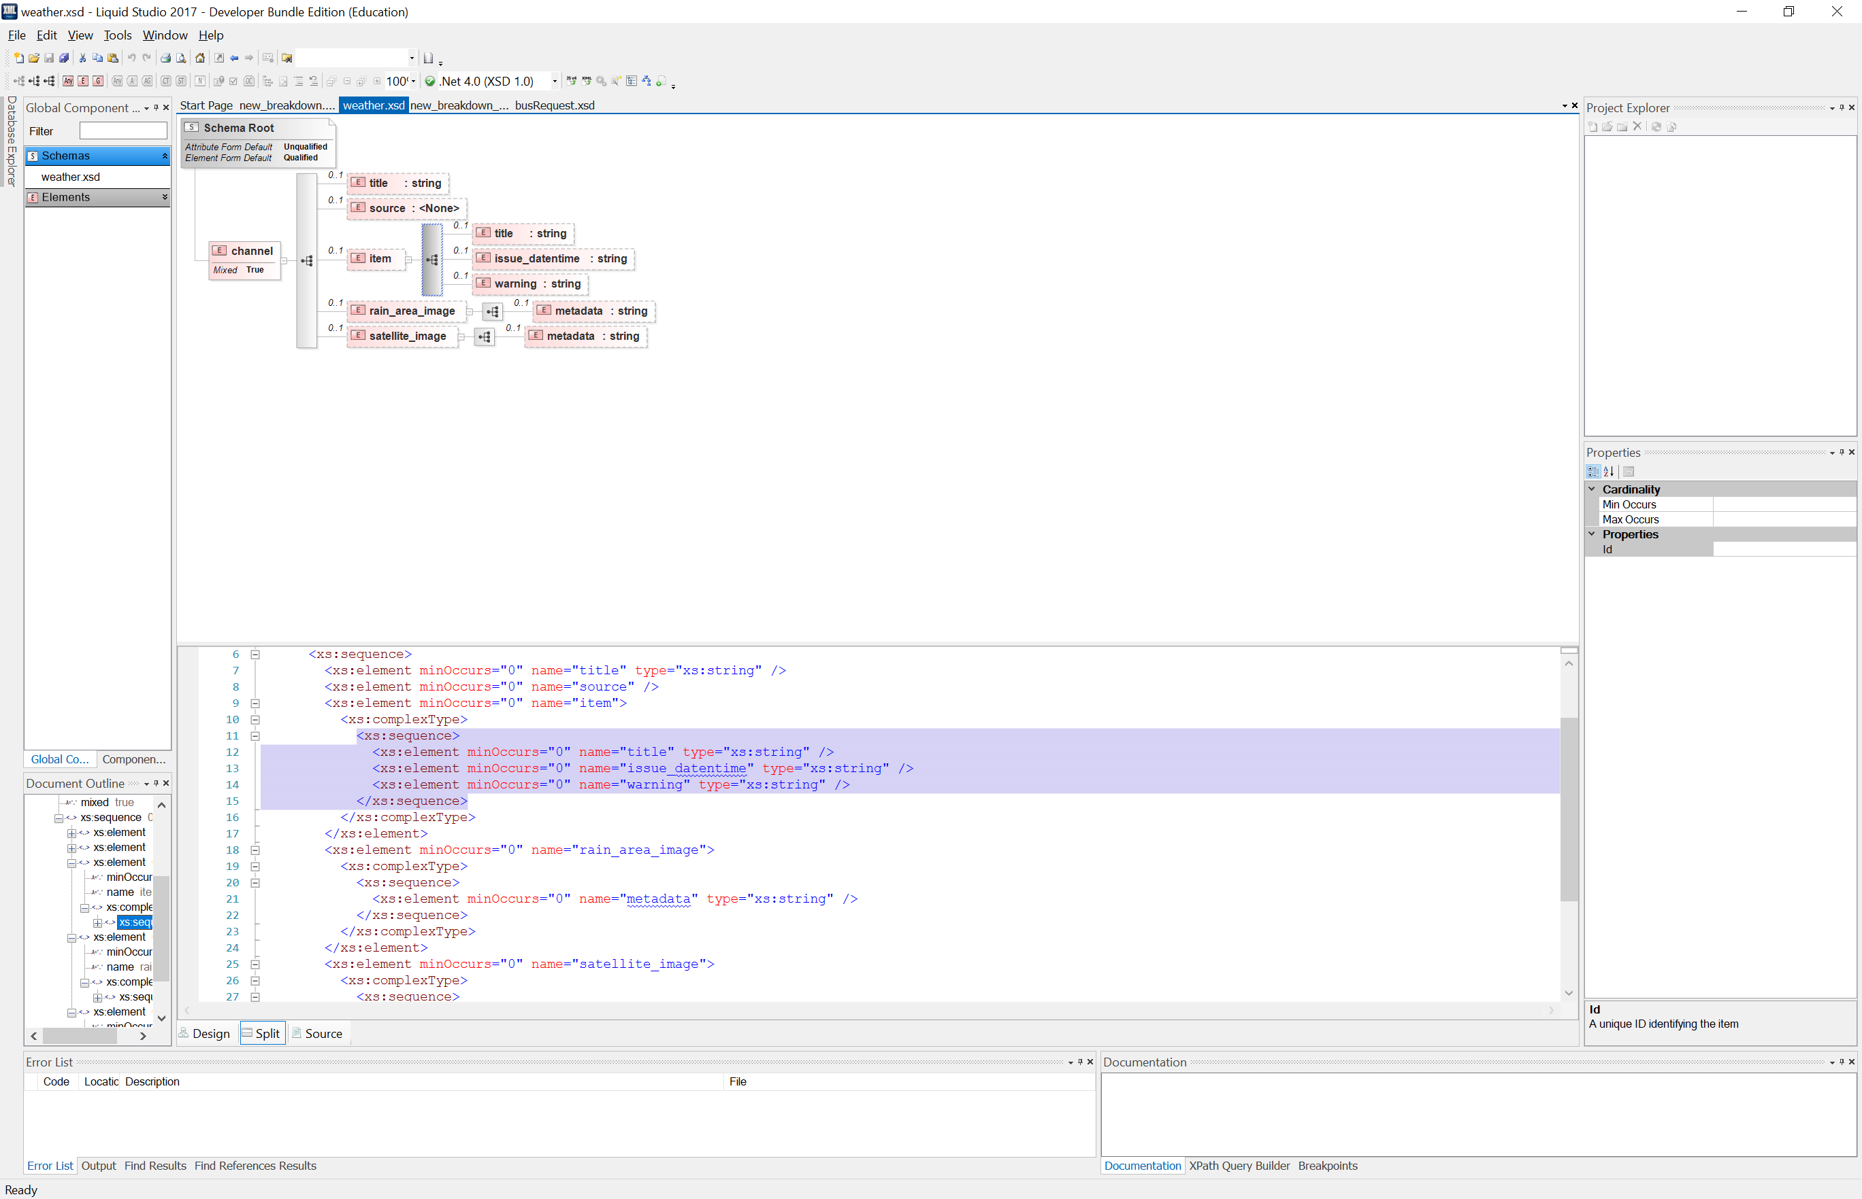
XML
<?xml version="1.0" encoding="UTF-8"?>
<busRequest>
<station>Tanah Merah Station</station>
<reason>Train Fault</reason>
<timestamp>2018-02-20T09:00:00</timestamp>
<coords>
<lat>1.3272383</lat>
<long>103.9443528</long>
</coords>
</busRequest>
busRequest.xsd
<channel>
<title>Heavy Rain Warning</title>
<source>Meteorological Service Singapore </source>
<item>
<title>HEAVY RAIN WARNING</title>
<issue_datentime>-</issue_datentime>
<warning> TRUE</warning>
</item>
<rain_area_image><metadata>null</metadata></rain_area_image>
<satellite_image><metadata>null</metadata></satellite_image>
</channel>
weather.xsd

Slide 19
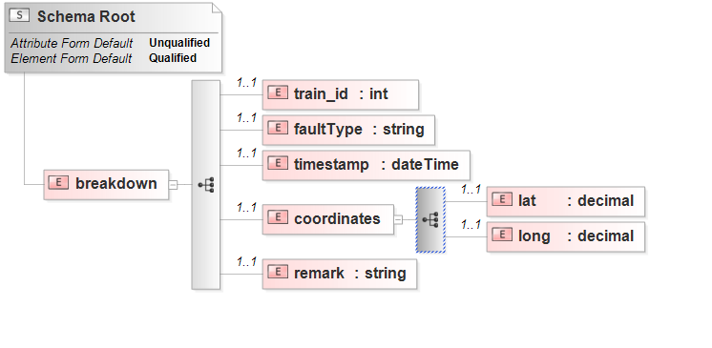
Data Transformation
concat()
new_breakdown.xsd
new_breakdown_formatted.xsd

Slide 20
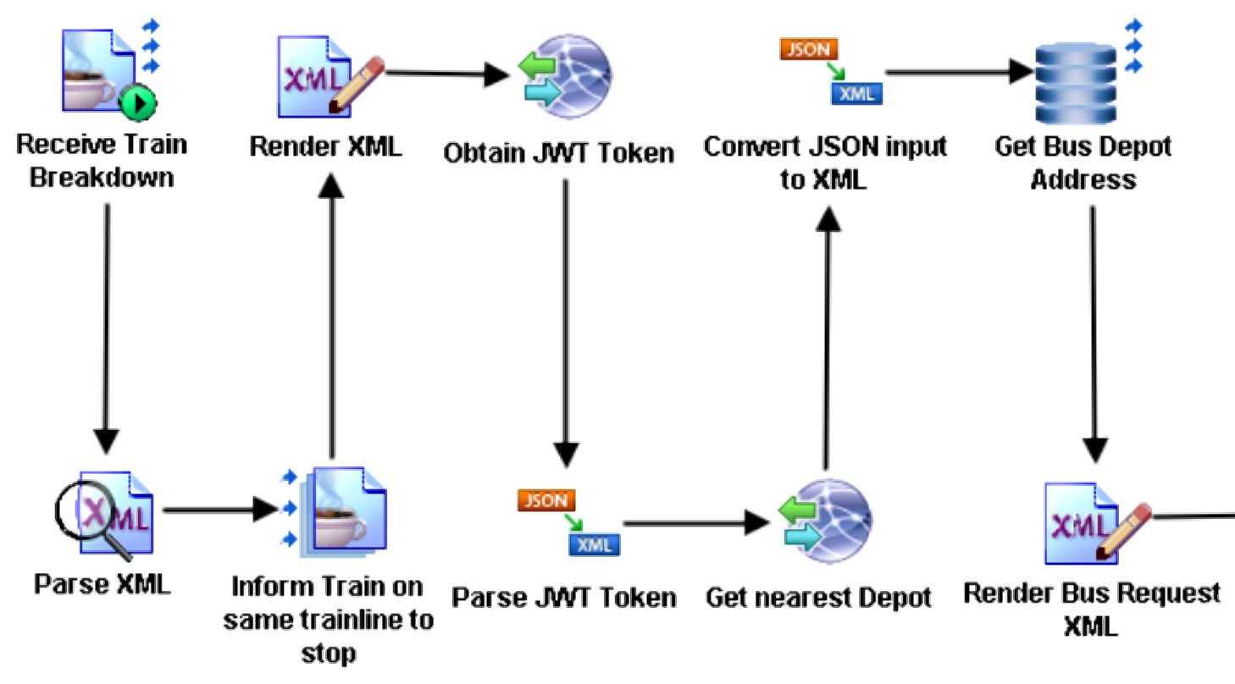
Content Routing
Get Queue address of the selected depot and route it to the correct depot
Decide which Depot is the nearest to incident

Slide 21
Beyond the Labs
3
Hosted Environment
Microsoft Azure, Heroku, Localhost
4
Programming Languages
C#, Java, PHP, Python
7
Out-of-Class TIBCO BW Palettee
Waiting for JMS Message, Assigning variable on IM, Twitter Plugin, Send Mail, Timer, File Poller, Grouping (Repeat-on-Error-till-True)

Slide 22
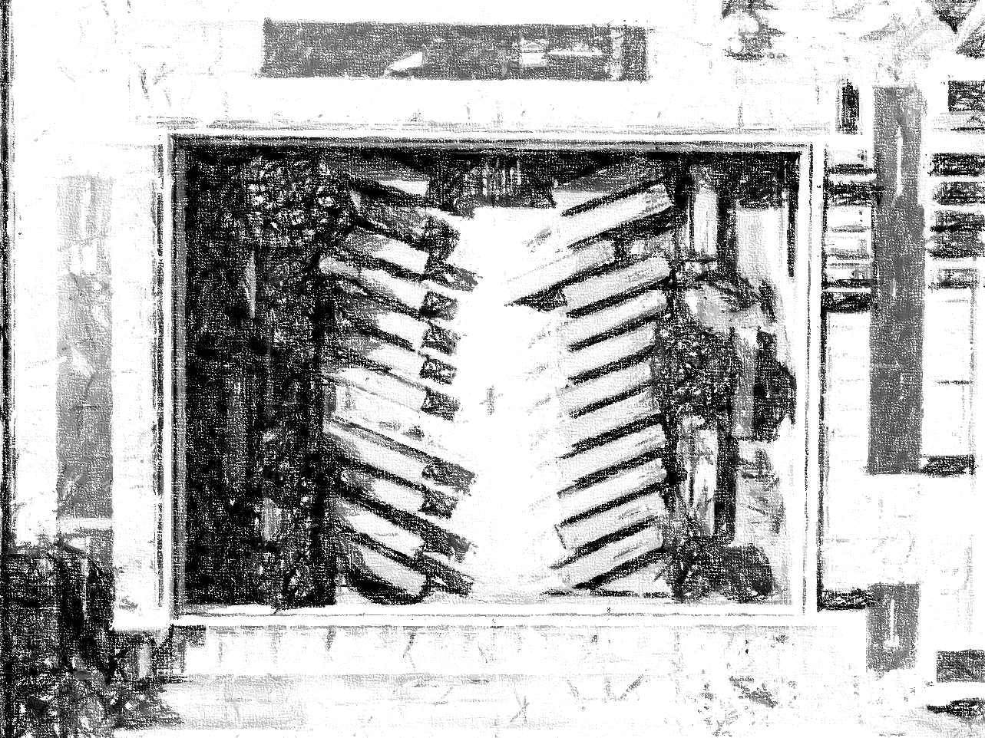
Demo Time

